Slide 1
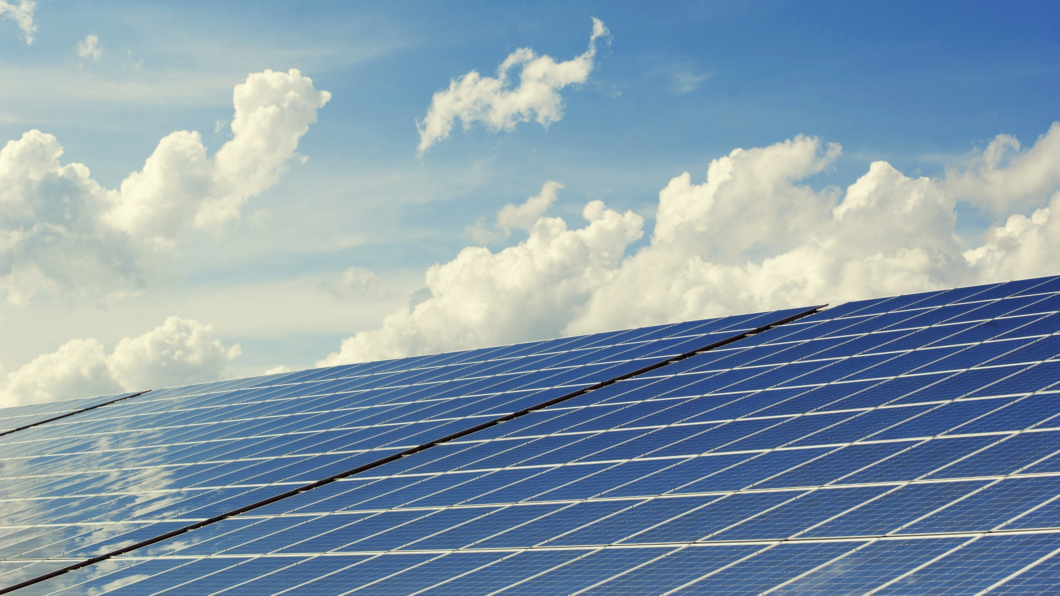

BQOM 2521 Renewable Energy Decisions in Bavaria Analyzed via an AHP Model Aman, Aurora, Pratik, Yuanzhe

Slide 2
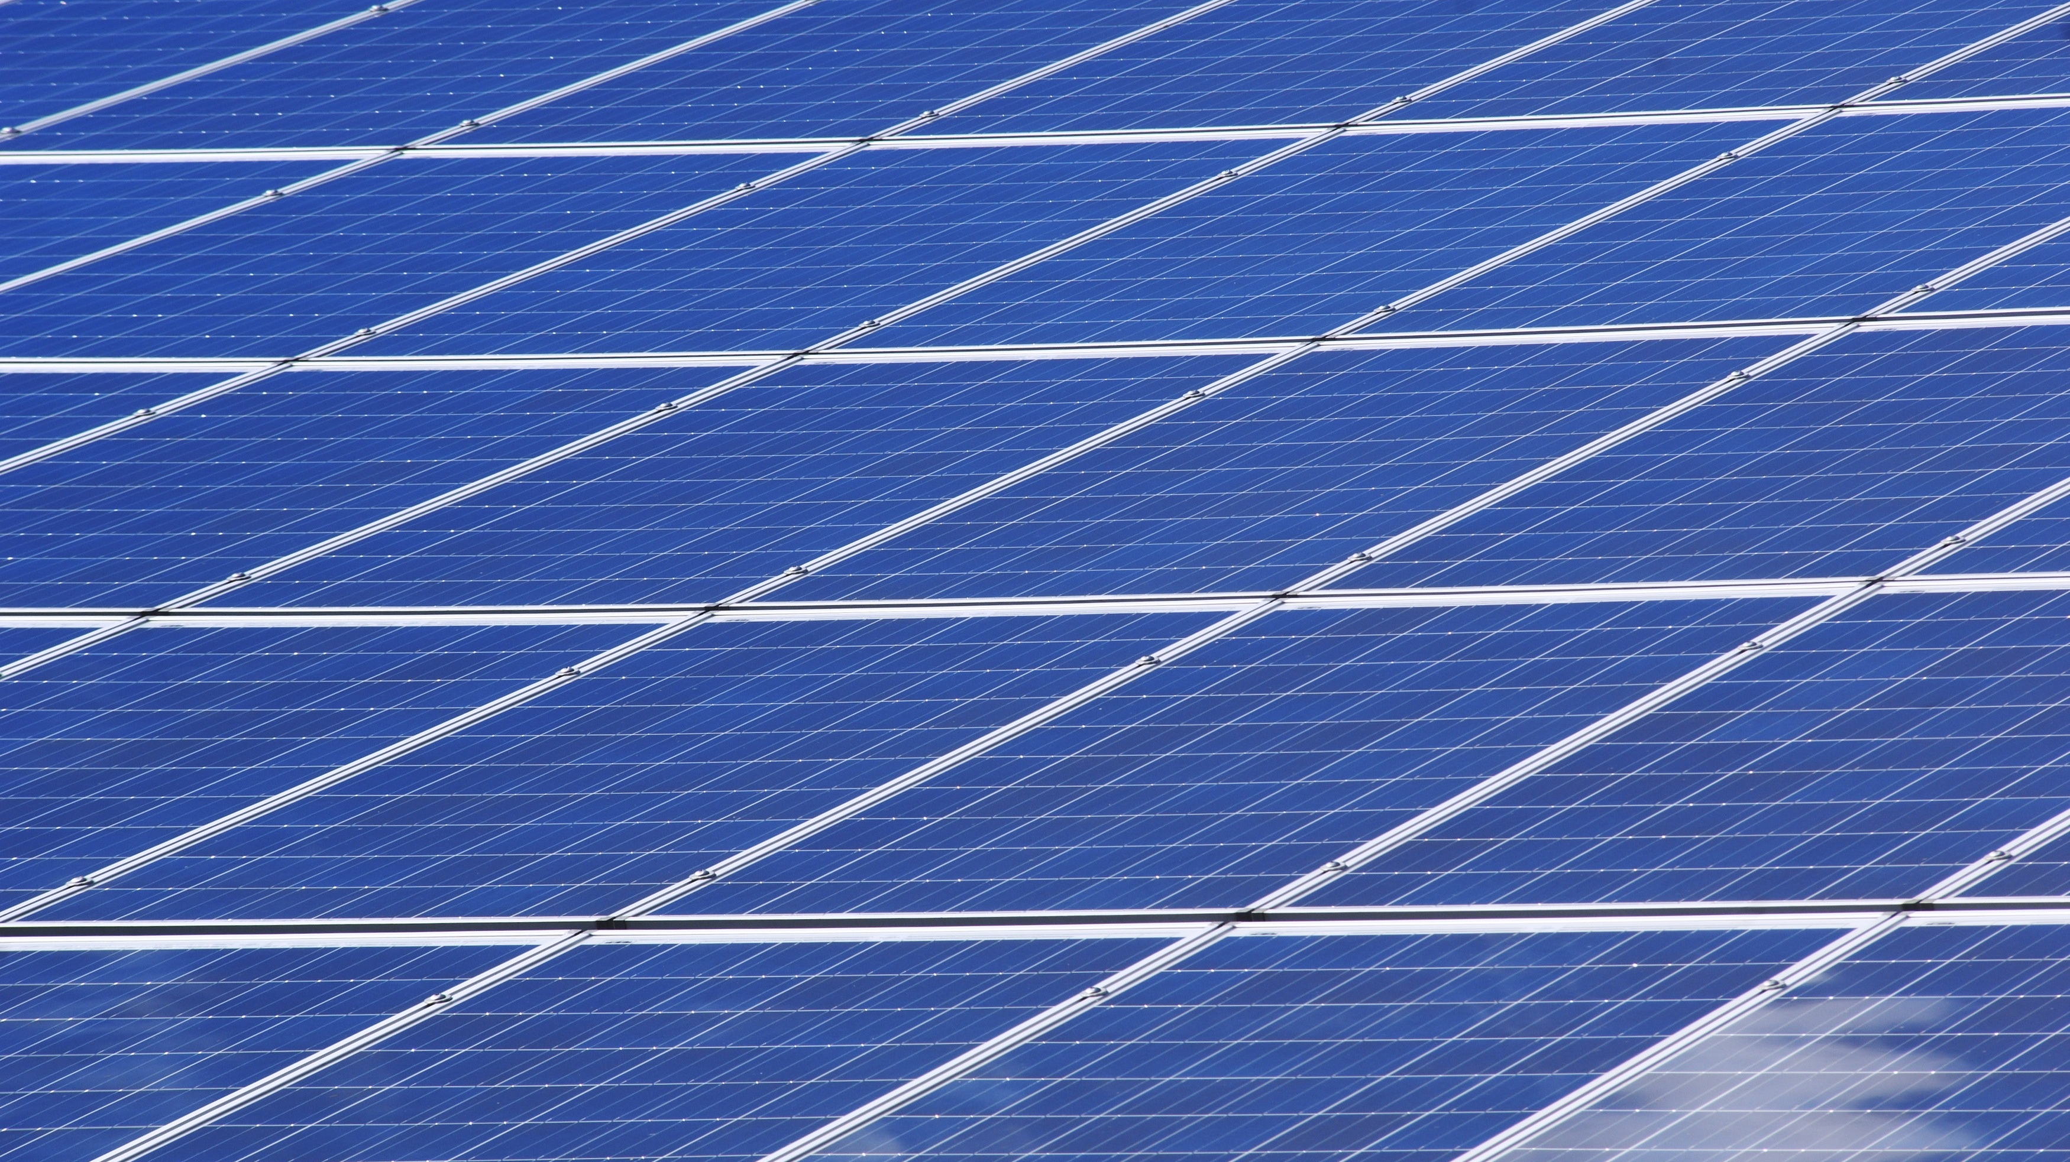
01 | The Energy Landscape in Germany
02 | Renewable Energy Infrastructure in Bavaria
03 | AHP Model
04 | Criteria
05 | Interview Questions for iST
06 | Sensitivity Analysis
07 | Ratings Model
08 | Resource Allocation

Slide 3
Germany Energy Landscape
A significant portion of Germany’s power needs are fulfilled by renewable sources.
Nearly 41% of Germany’s electricity needs are fulfilled by renewable sources (2021)
Notes:
https://www.cleanenergywire.org/factsheets/germanys-energy-consumption-and-power-mix-charts

Slide 4
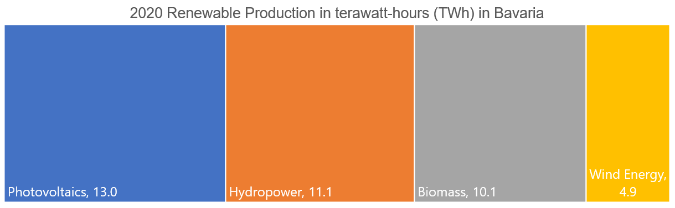
Bavaria Energy Landscape
A significant portion of Germany’s power needs are fulfilled by renewable sources.
Current State More than 52% of Bavaria’s electricity needs are fulfilled by renewable sources (2020) | Future Goals Double power generation from renewable sources by 2030
Notes:
https://www.cleanenergywire.org/factsheets/germanys-energy-consumption-and-power-mix-charts

Slide 5
AHP Model
The hierarchy for the AHP model includes a decision goal, decision criteria, and alternatives
GOAL
Amount of Electricity
Reliability
Costs
Environmental Impact
Energy Amortization
Potential
Operating Costs
Electric Production Costs
Wind
Photovoltaic
HydroElectric

Slide 6
Criteria Weightages
Amount of electricity, potential, and reliability have the highest weights.

Slide 7
Quantitative Criteria
For each alternative we have created a profile so that the judgments are based on facts
Quantitative | Wind | Photovoltaic | HydroElectrics
Amount of Electricity [kwh/year] | 10,000,000 | 3,300,000 | 3,200,000
Operating Costs [€/kWh] | 0.1 | 0.0064 | 0.0125
Electric Production Cost [ct/kWh] | 7.35 | 5 | 9.5
Energy Amortization [year] | 0.75 | 2.7 | 1.5

Slide 8
Qualitative Criteria
For each alternative we have created a profile so that the judgments are based on facts
Qualitative | Wind | Photovoltaic | HydroElectrics
Reliability | Good seasonal correlation of electricity production and increased electricity demand in winter | Irregular availability, strong fluctuations in energy production | Seasonal and precipitation-related fluctuations
Environmental Impact | Conflicts with species protection possible. | Low environmental impact in production and operation Free-field plants: high are requirement | Disturbance of watercourse structure and ecology, including watercourse continuity
Potential | High unused potential | High unused potential | Already a lot of Hydroelectric power stations installed in Bavaria

Slide 9
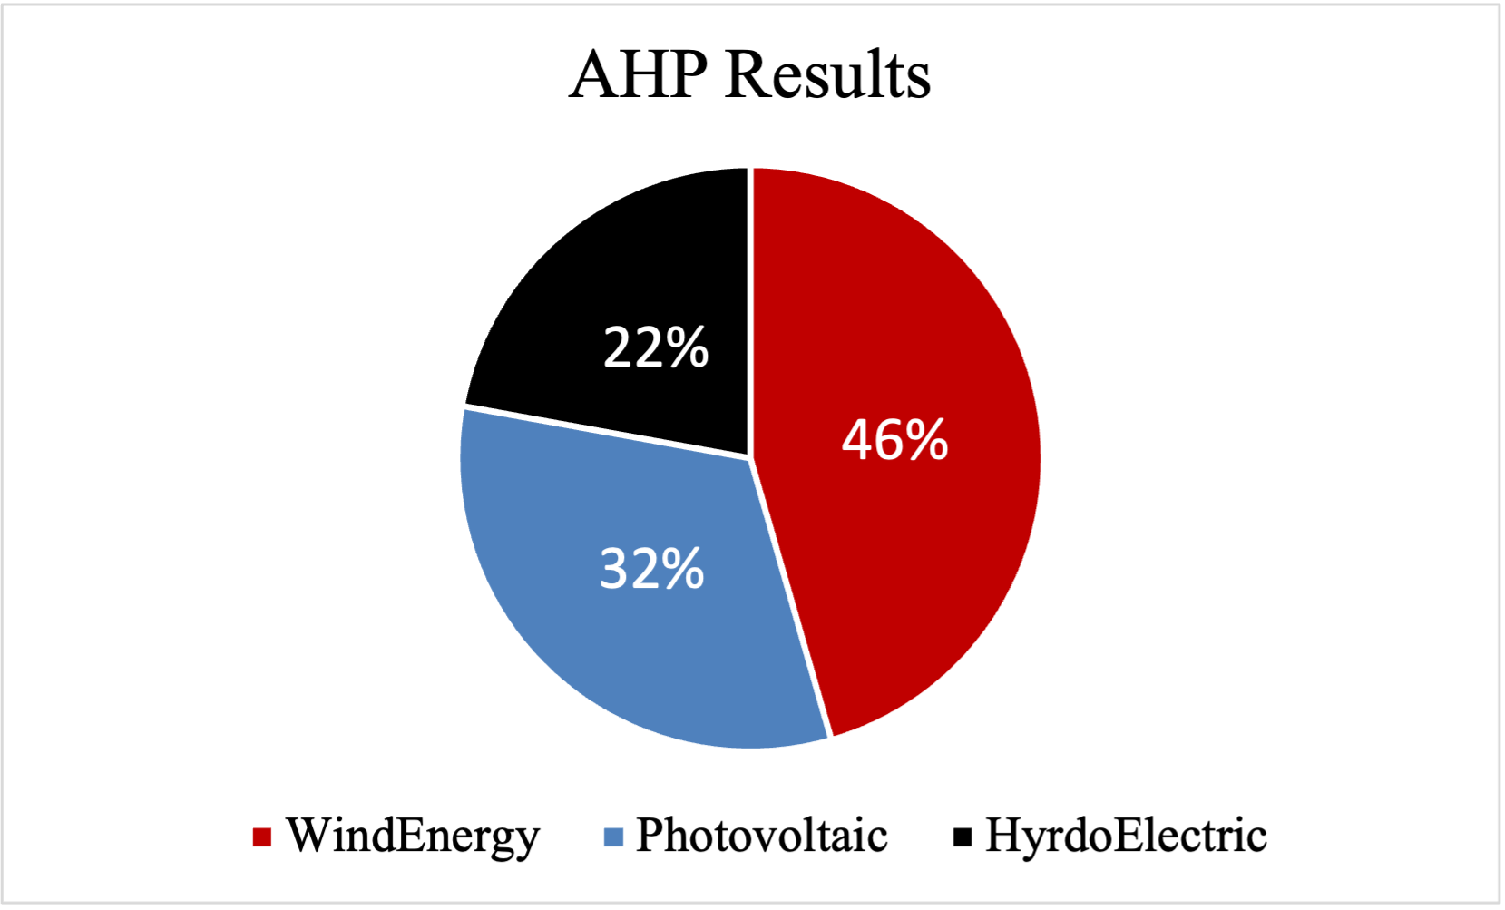
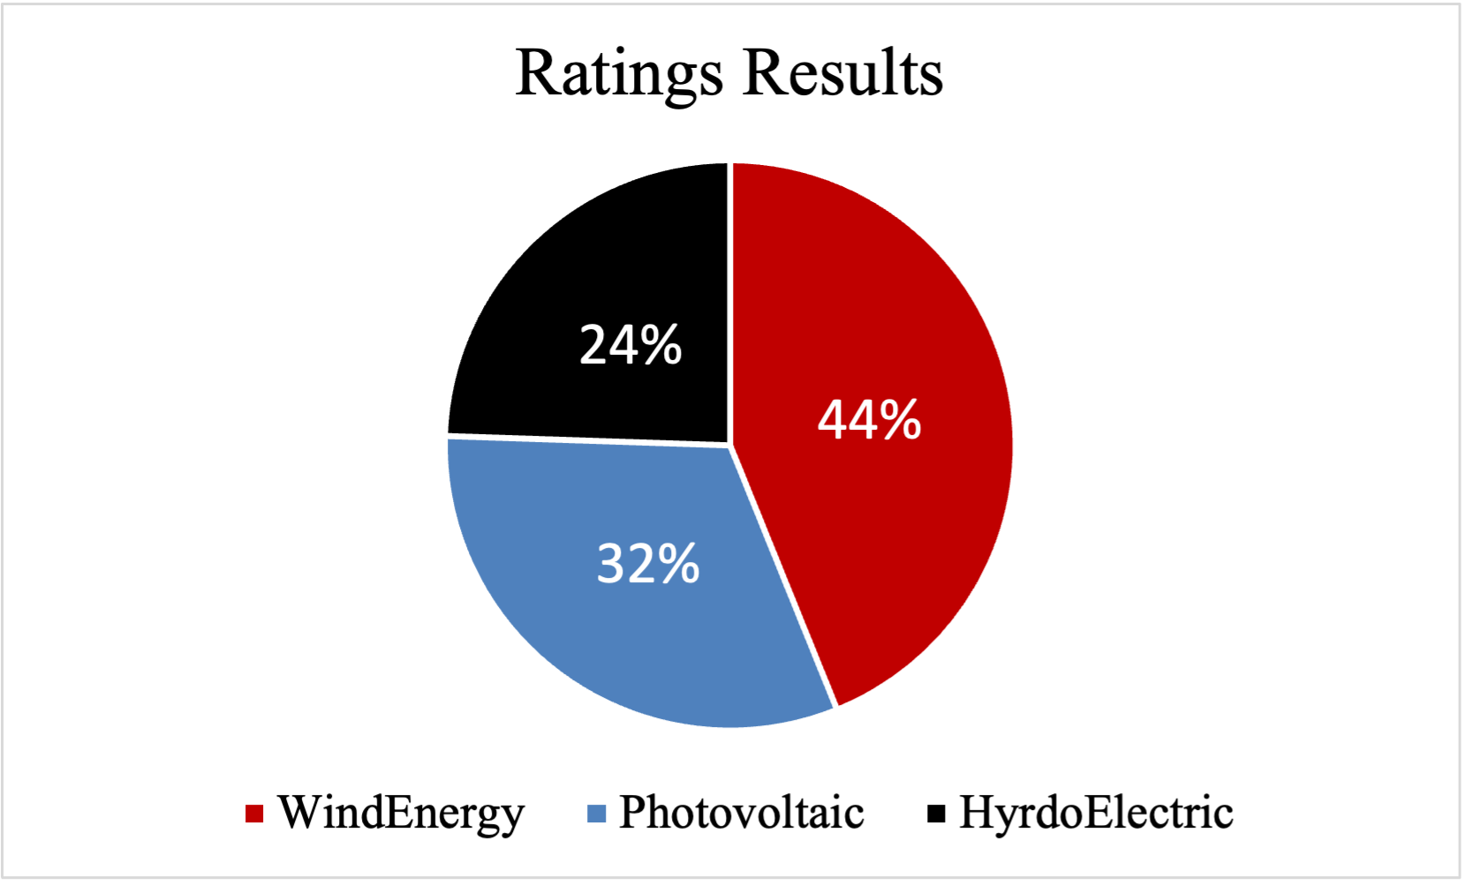
Results Ratings & AHP Model
Wind Energy is the best alternative in both model types.
AHP result: Wind Energy > Photovoltaic > Hydro Electric
Ratings result: Wind Energy > Photovoltaic > Hydro Electric
Notes:
https://www.cleanenergywire.org/factsheets/germanys-energy-consumption-and-power-mix-charts

Slide 10
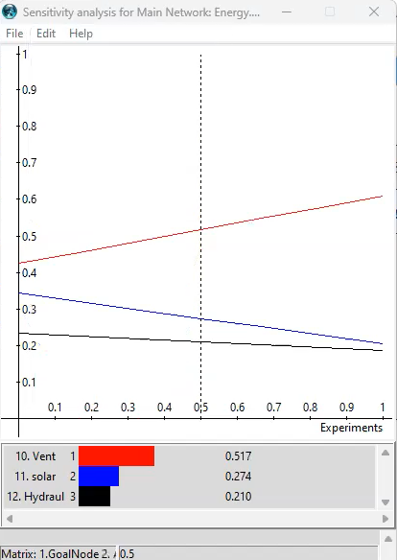
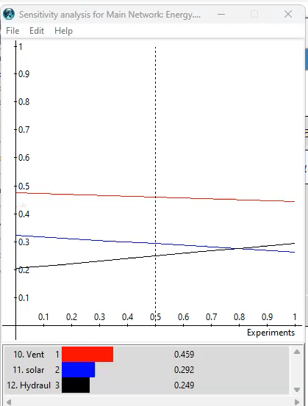
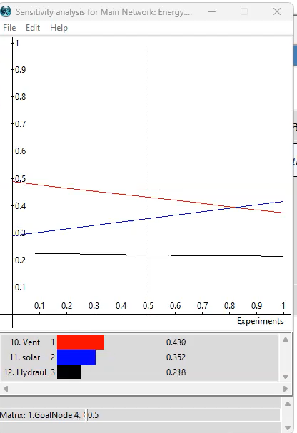
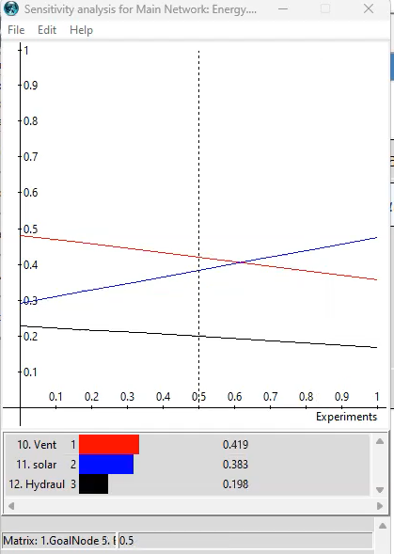
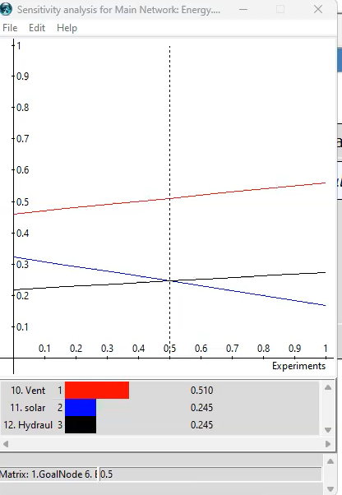
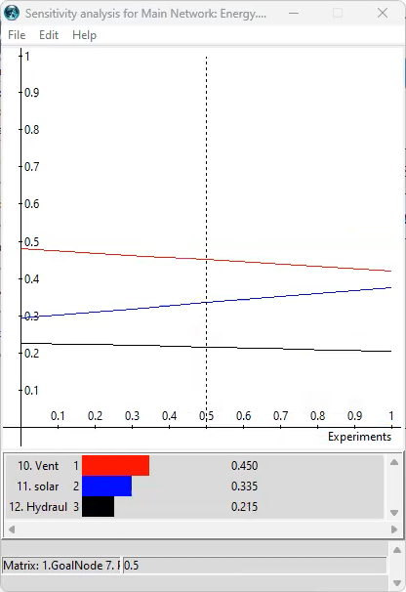
Sensitivity Analysis
Amount of Electricity
Reliability
Costs
Wind
Photovoltaic
Hydro Electrics
Summary
The result shows the model is robust
Environmental Impact
Energy Amortization
Potential

Slide 11

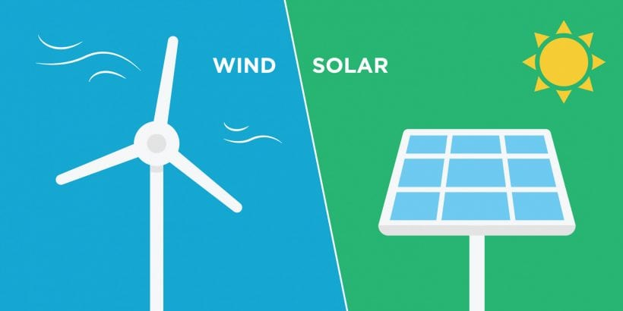

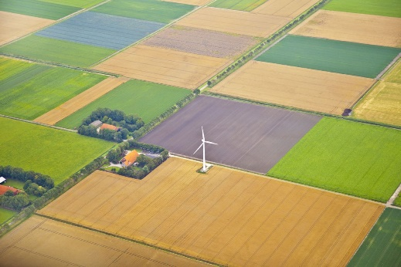
Germany Resource Allocation
Wind | Photovoltaic | HydroElectric
Rating
Constraints
2 : 1
Budget: Euro 850Mil
No more than 200 plot
Notes:
https://www.cleanenergywire.org/factsheets/germanys-energy-consumption-and-power-mix-charts

Slide 12

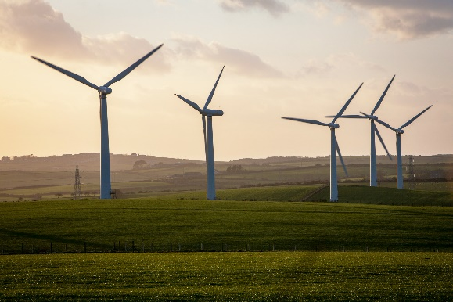
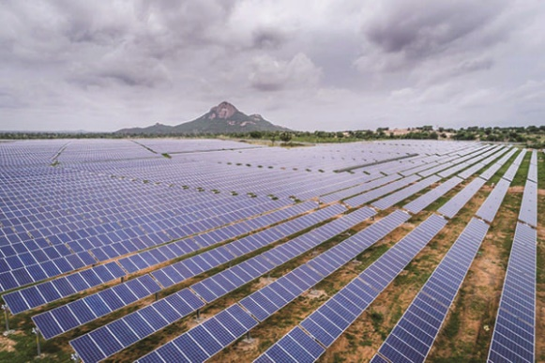
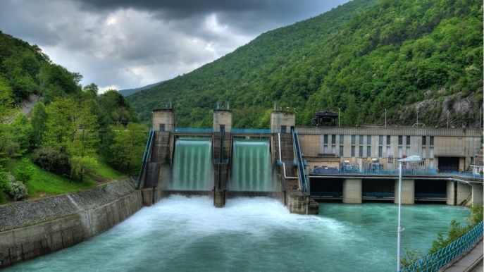
Germany Resource Allocation
Wind | Photovoltaic | HydroElectric
Wind: 57 nos.
Photovoltaic: 81 nos.
Hydroelectric: 0 nos.
Notes:
https://www.cleanenergywire.org/factsheets/germanys-energy-consumption-and-power-mix-charts

Slide 13
Thank You.
Notes:
https://www.cleanenergywire.org/factsheets/germanys-energy-consumption-and-power-mix-charts

